Slide 1

artists in the schools 2025
kentuck art center and festival
artists in the schools program

Slide 2
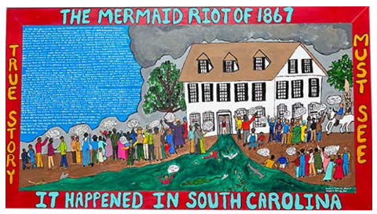
the mermaid riot of 1867 by justin atkin

Slide 3
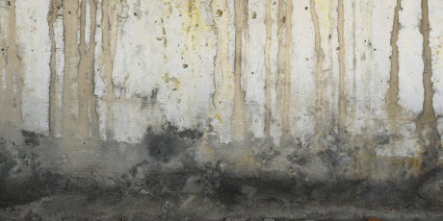
edge of the wood by john canterbury

Slide 4
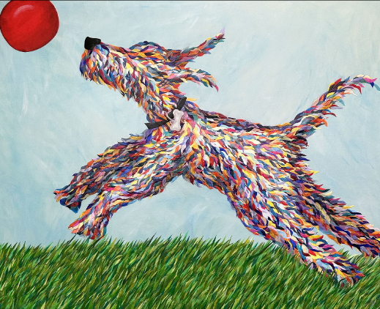
fetch by robin anne cooper

Slide 5
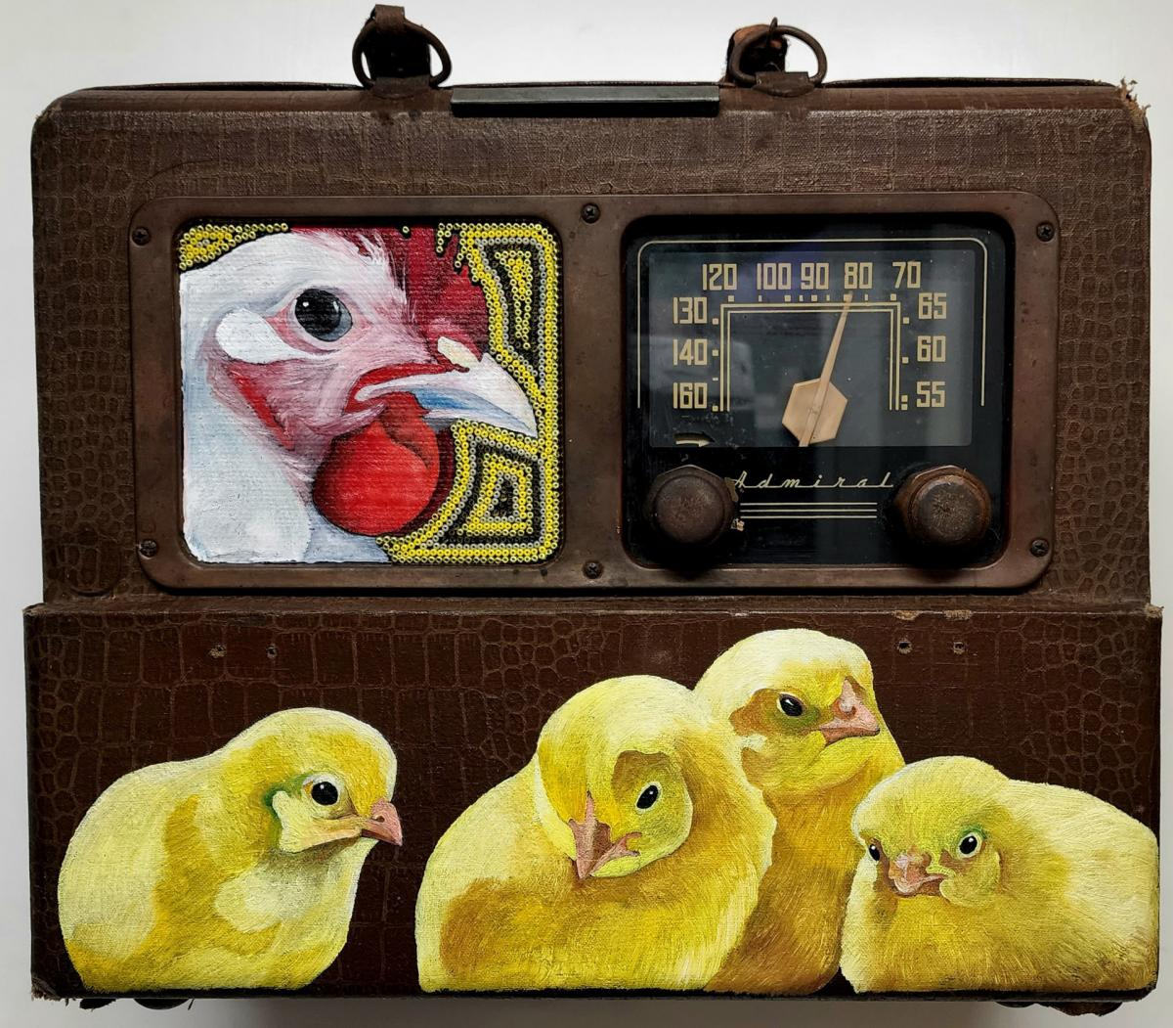
mother hen by penny dobson

Slide 6
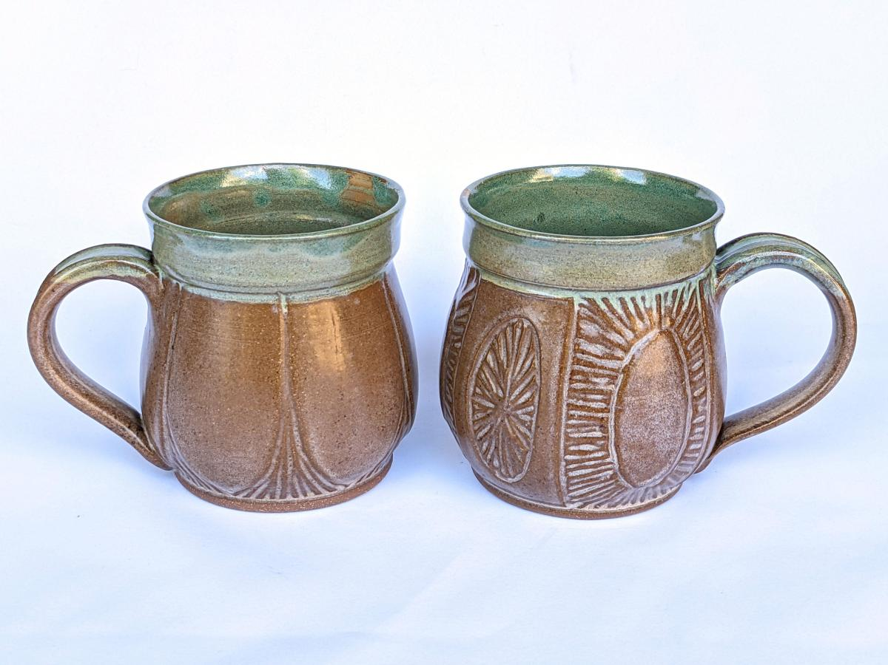
mug set by marysia galbraith

Slide 7
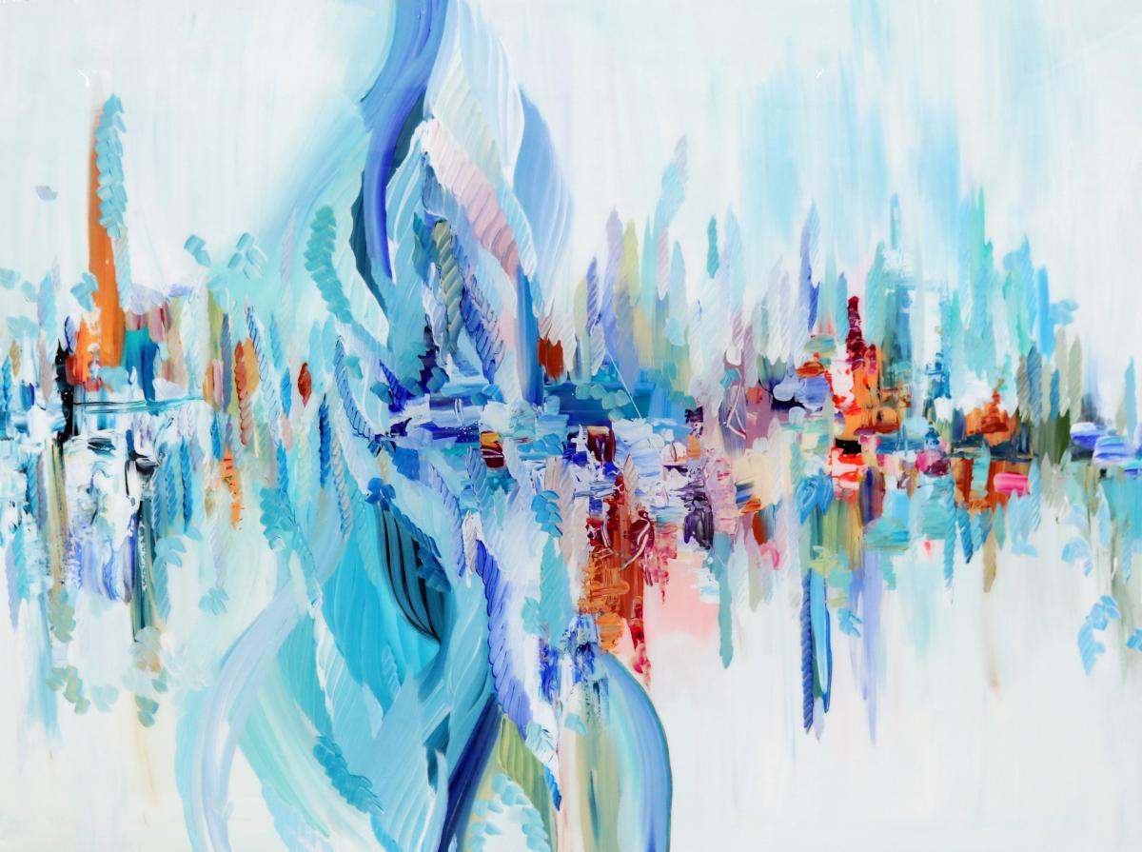
the afterglow by sydney gruber

Slide 8
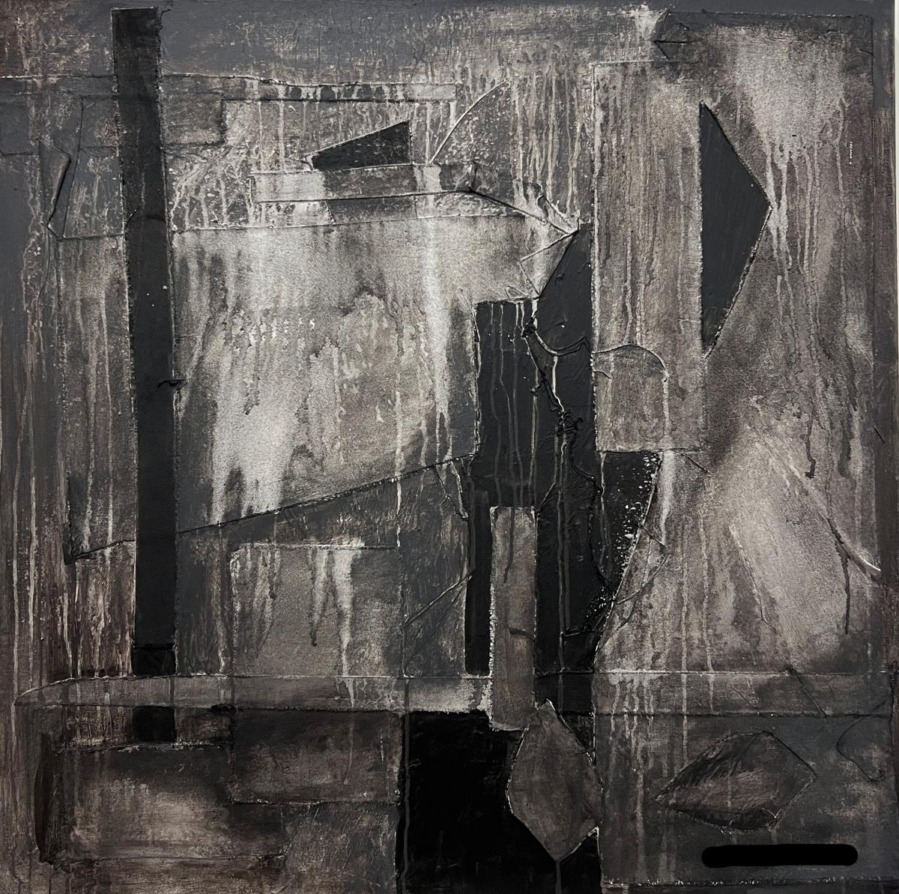
layered mist
by michael hand

Slide 9
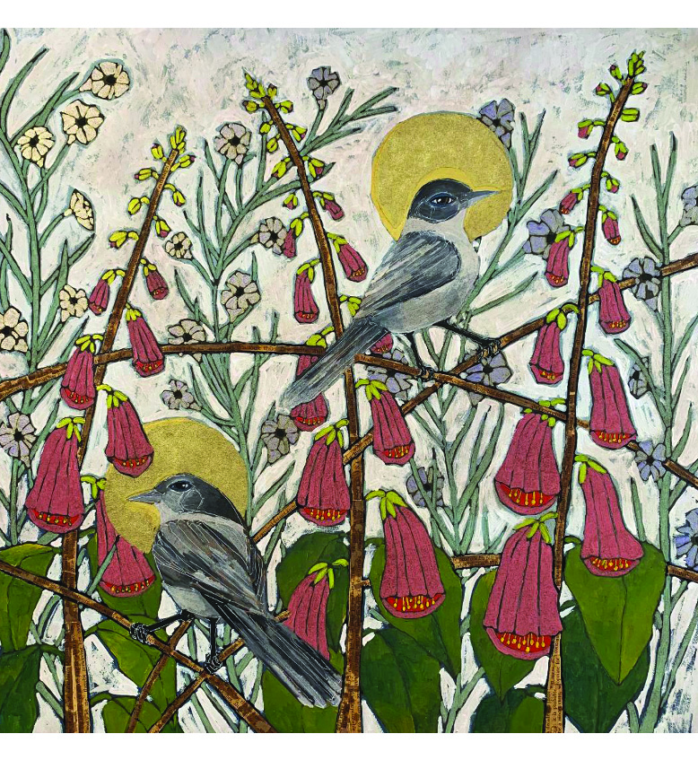
Untitled by kelly nicole hatfield

Slide 10
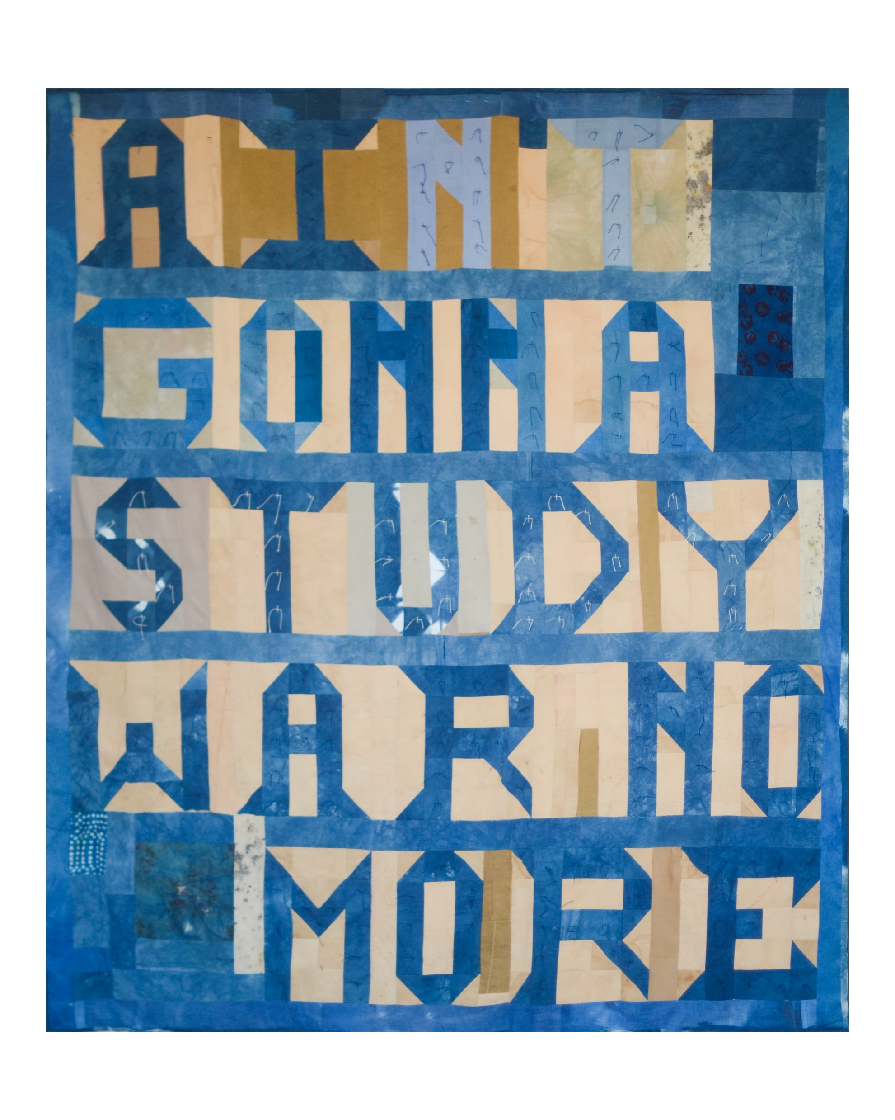
ain’t gonna study war
no more
by aaron sanders head

Slide 11
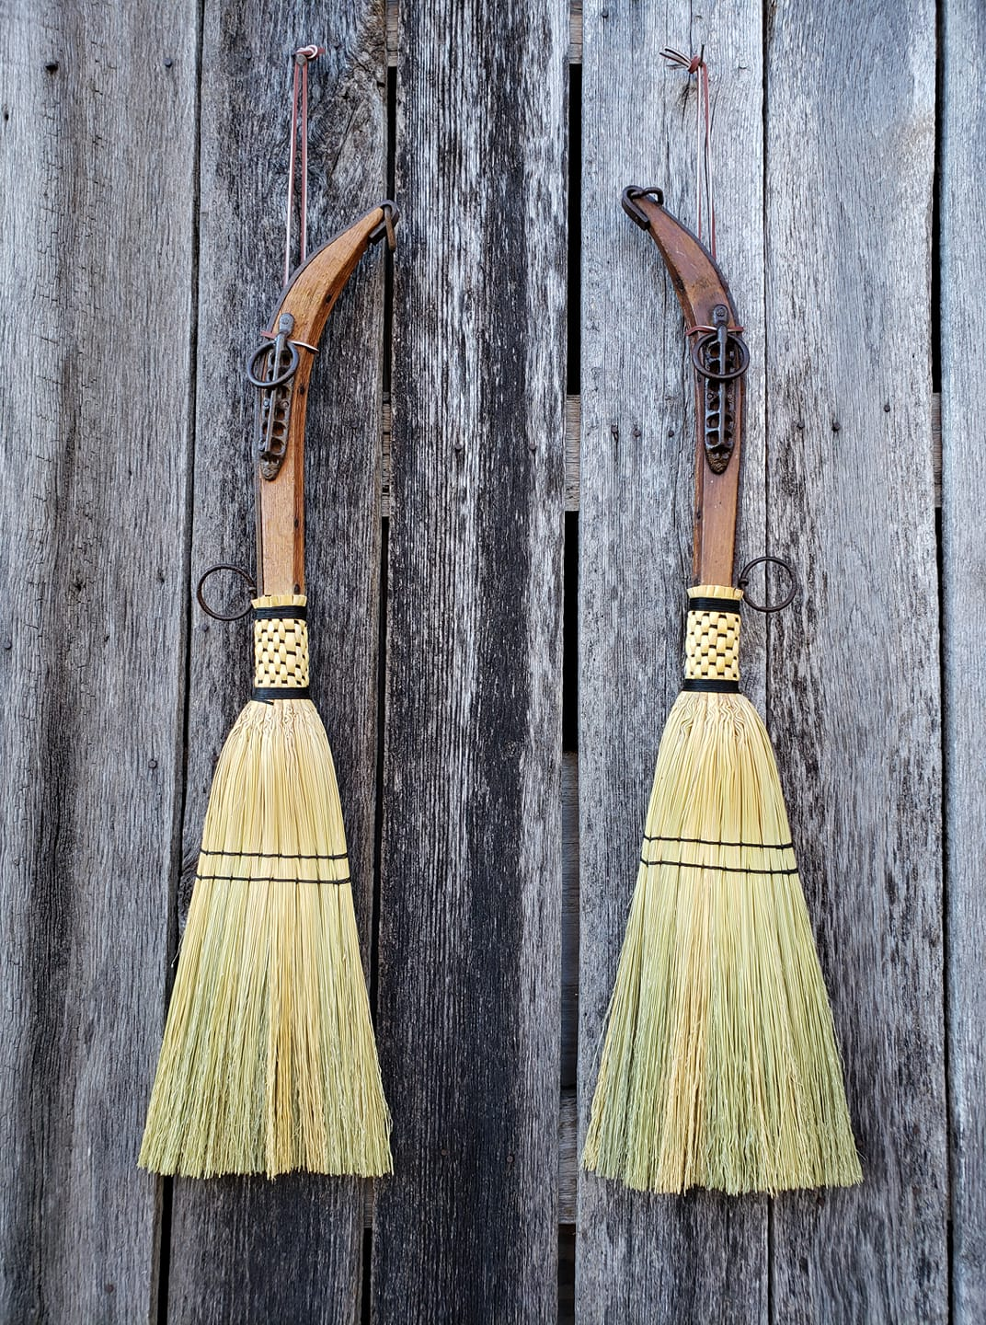
handmade brooms by george jones, jr.

Slide 12
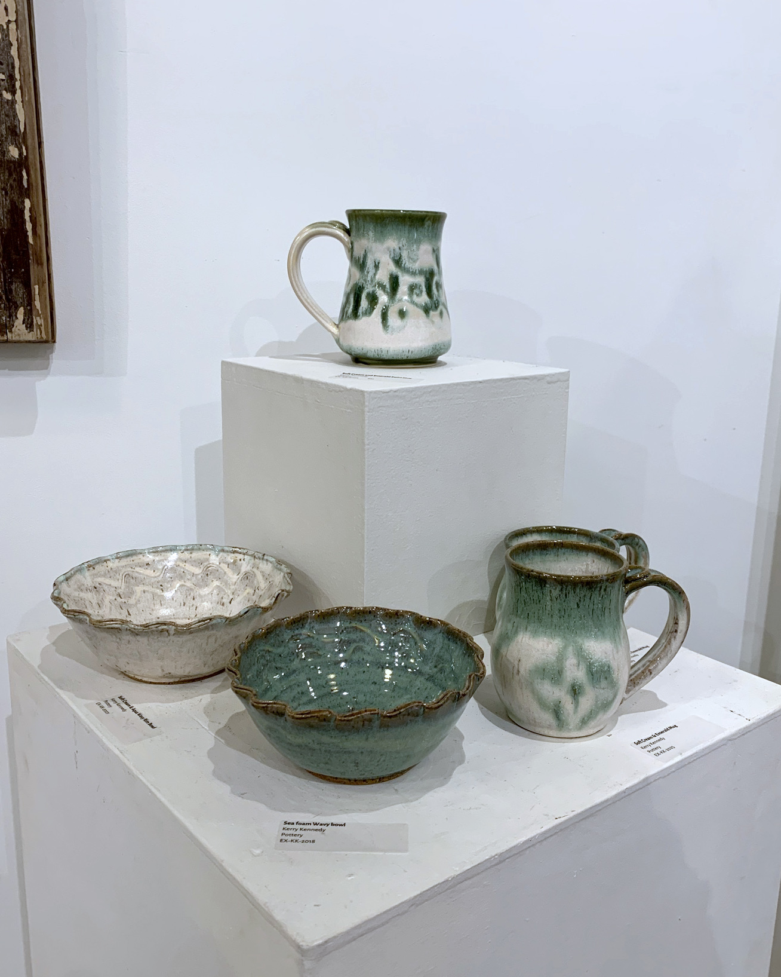
thrown and decorated pottery by kerry kennedy

Slide 13
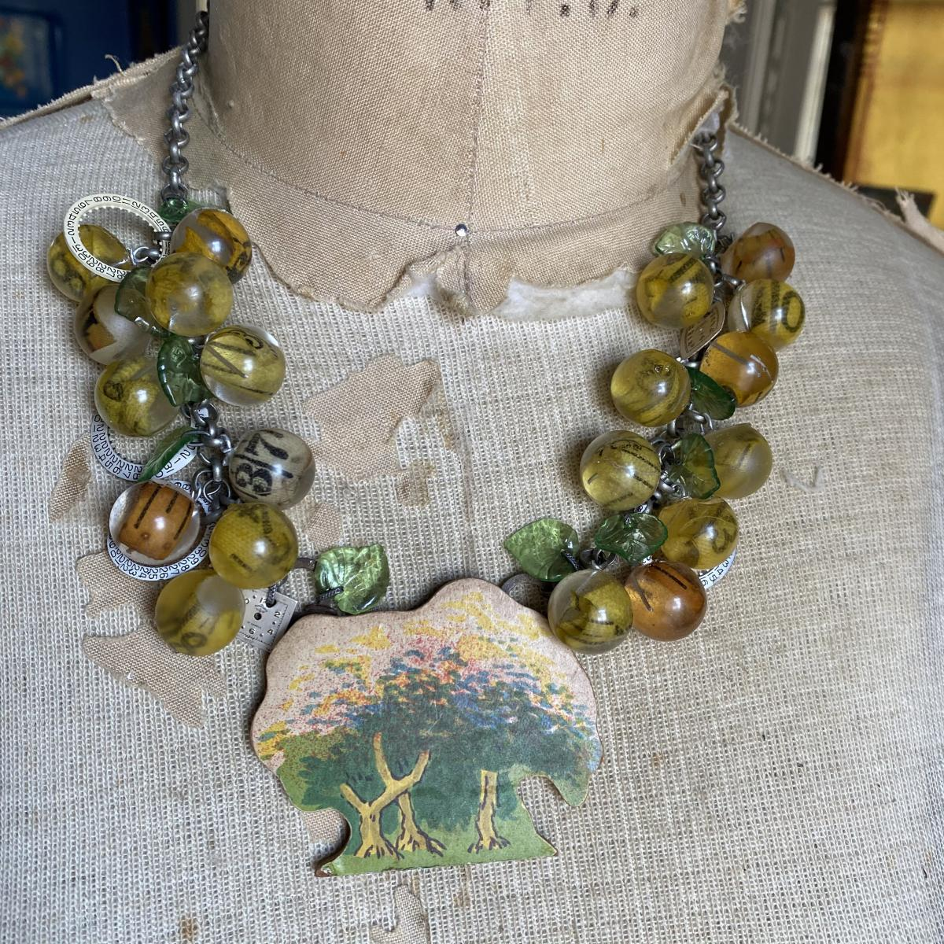
measured growth by kerry leasure

Slide 14
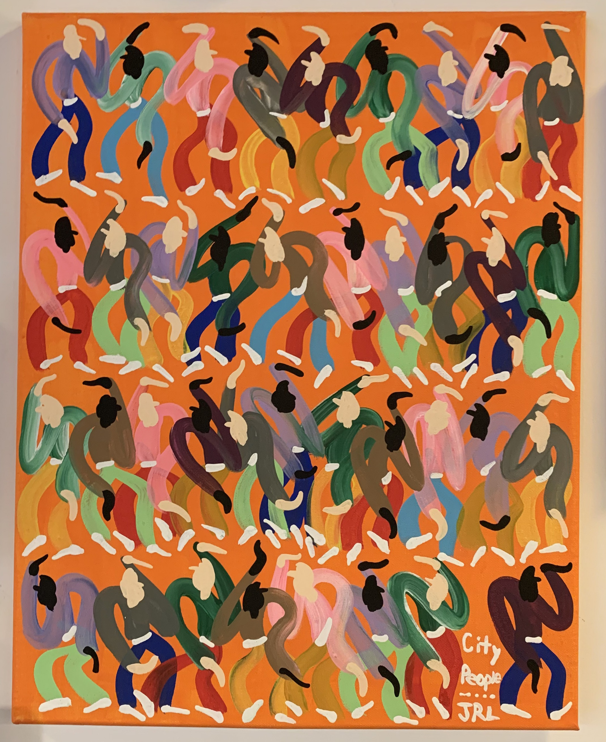
city people
by rik long

Slide 15
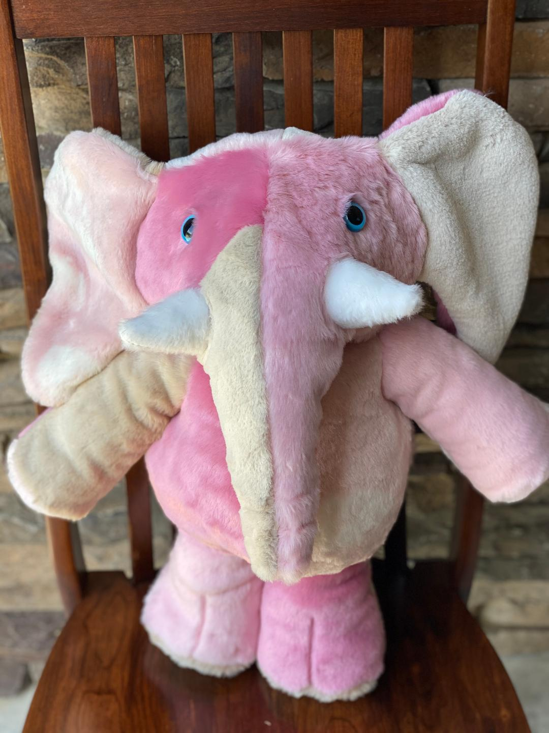
pink elephant by lucy’s toys

Slide 16
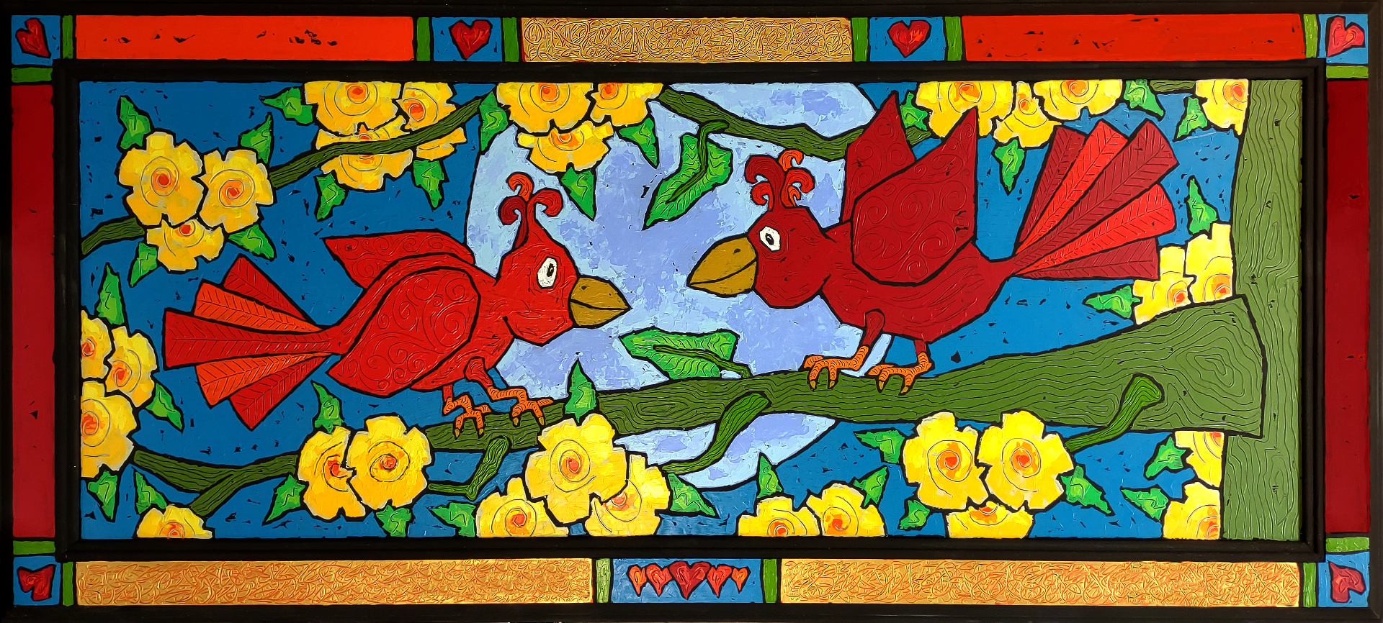
once in a blue moon by bob mcgill

Slide 17
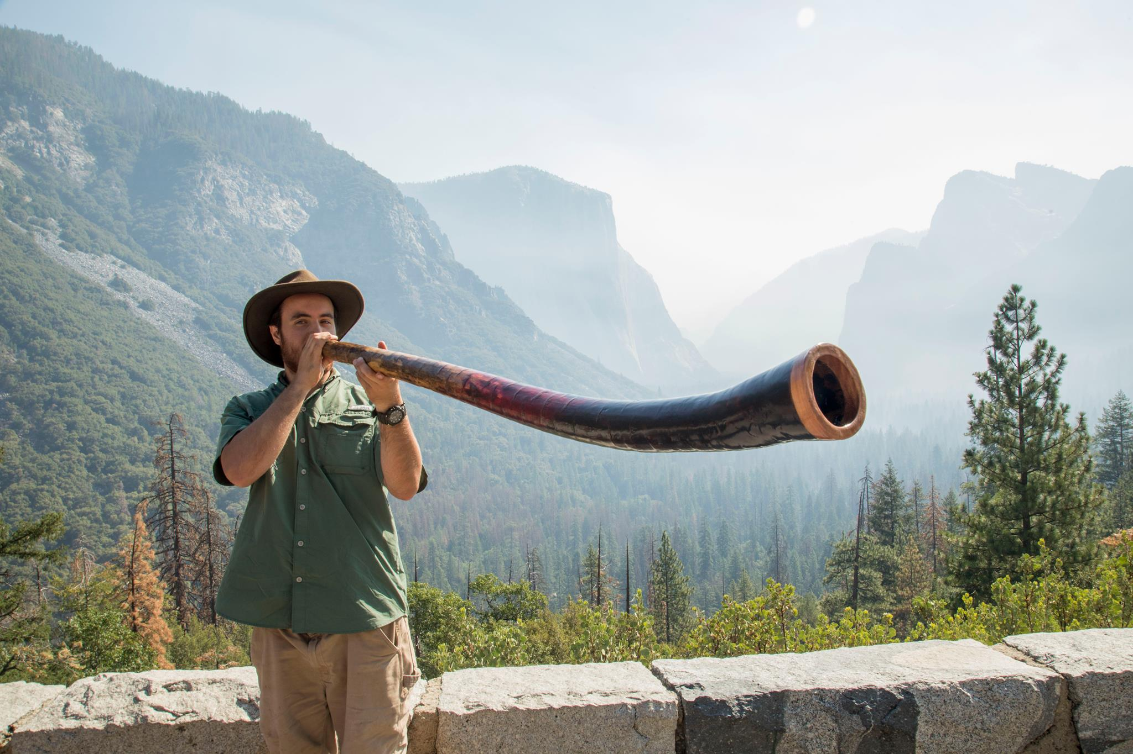
didgeridoo by william macgavin

Slide 18
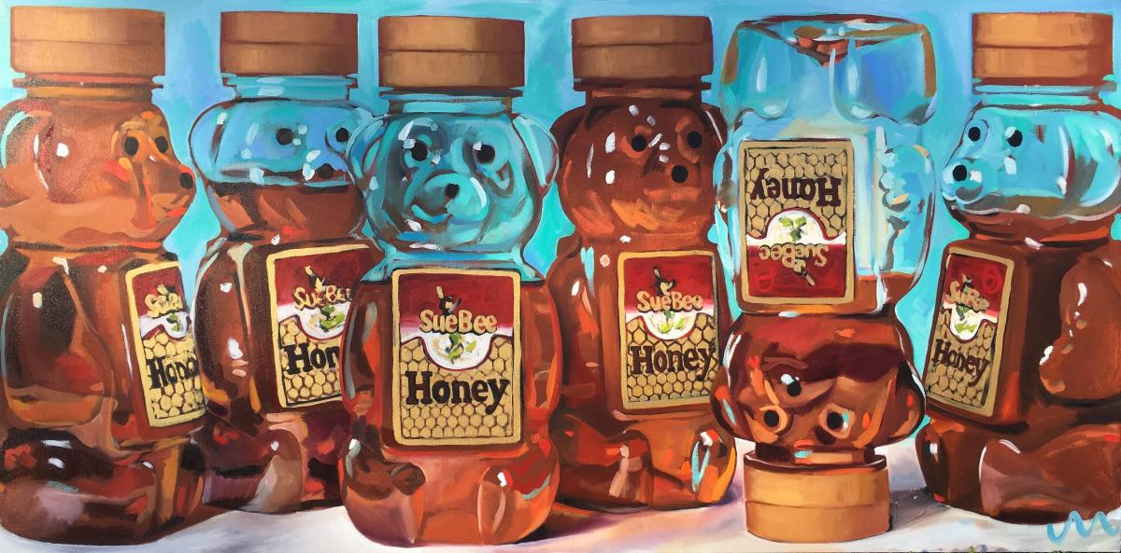
honey bears by jayne morgan

Slide 19
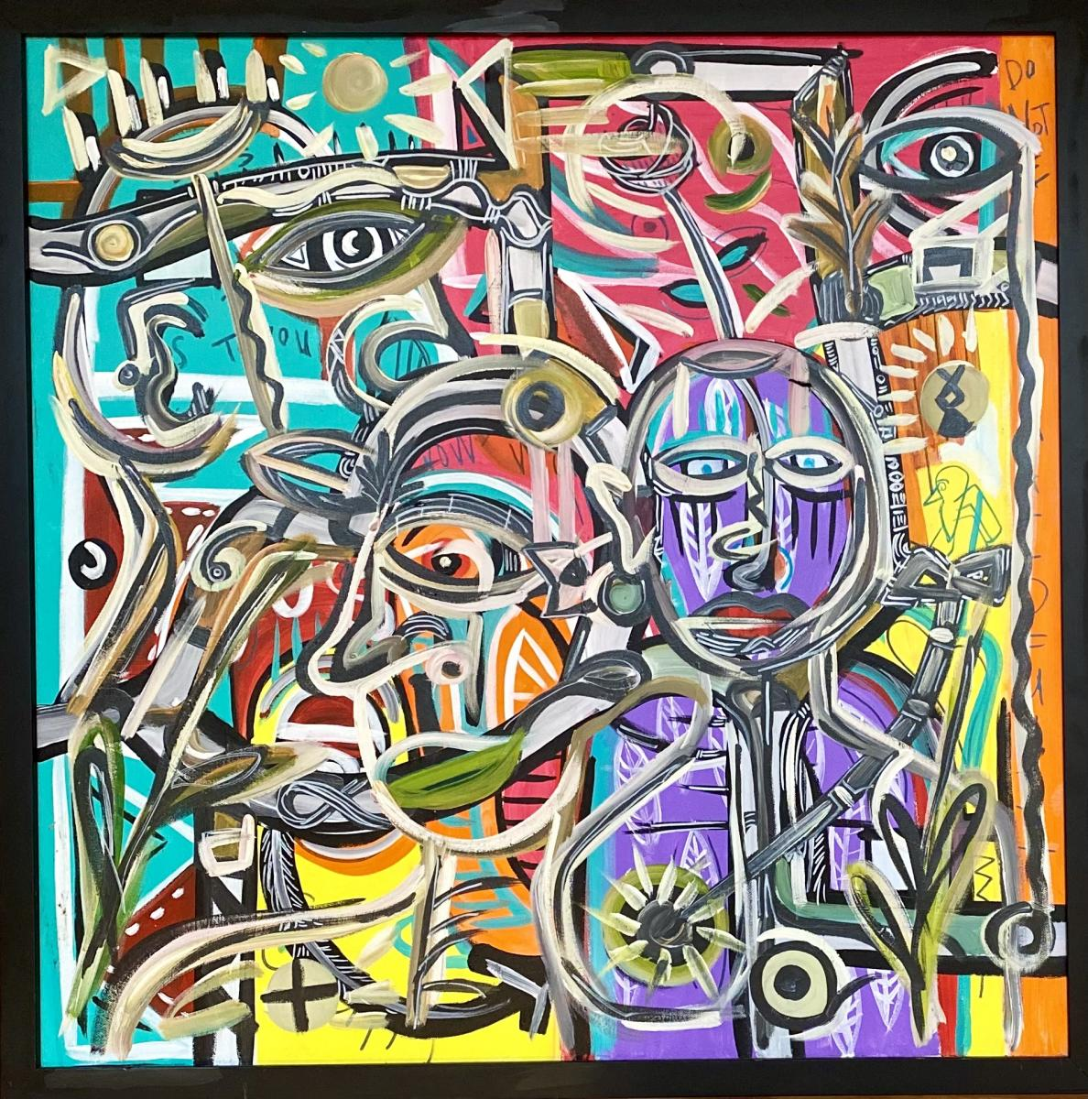
untitled
by jon osborne

Slide 20
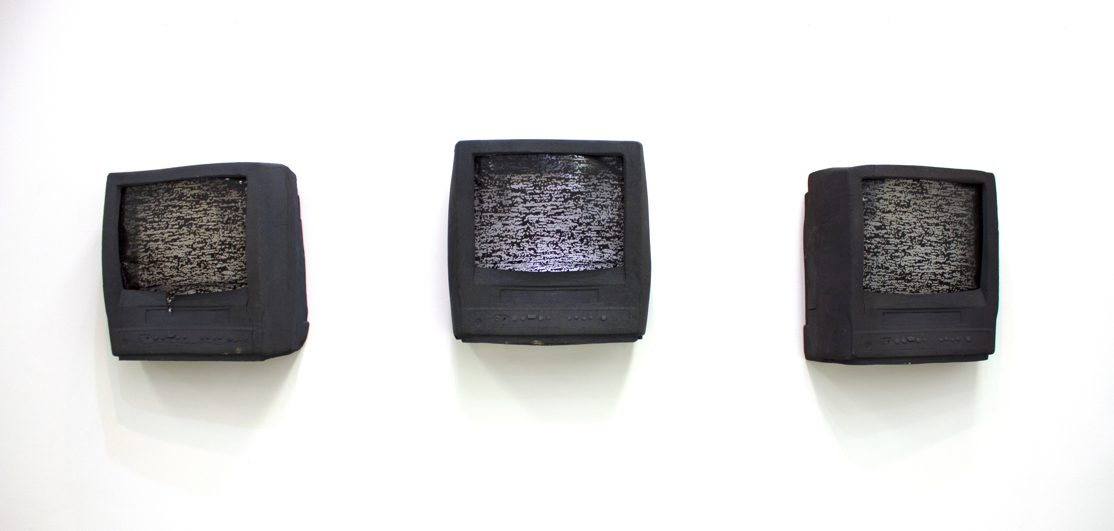
static by amy smoot

Slide 21
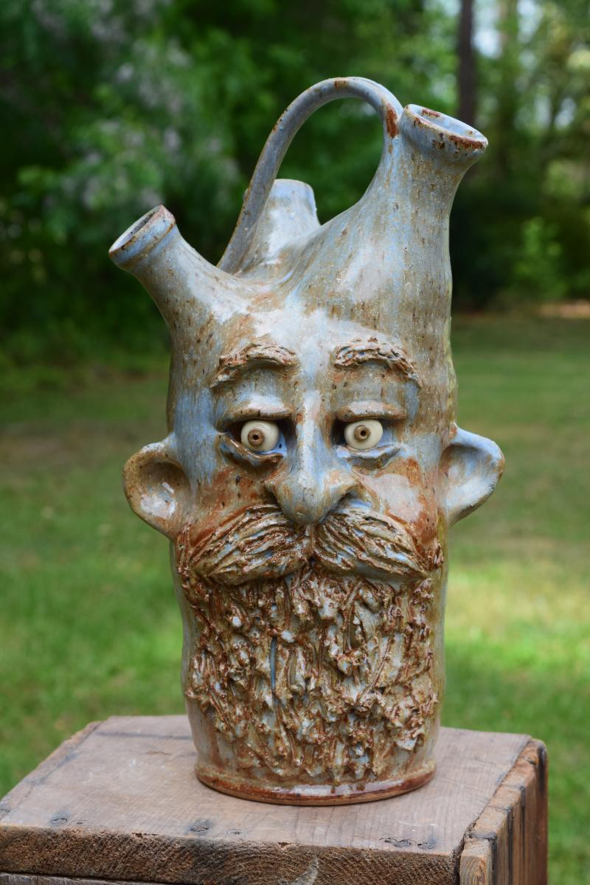
bearded face jug by tim whitten

Slide 22
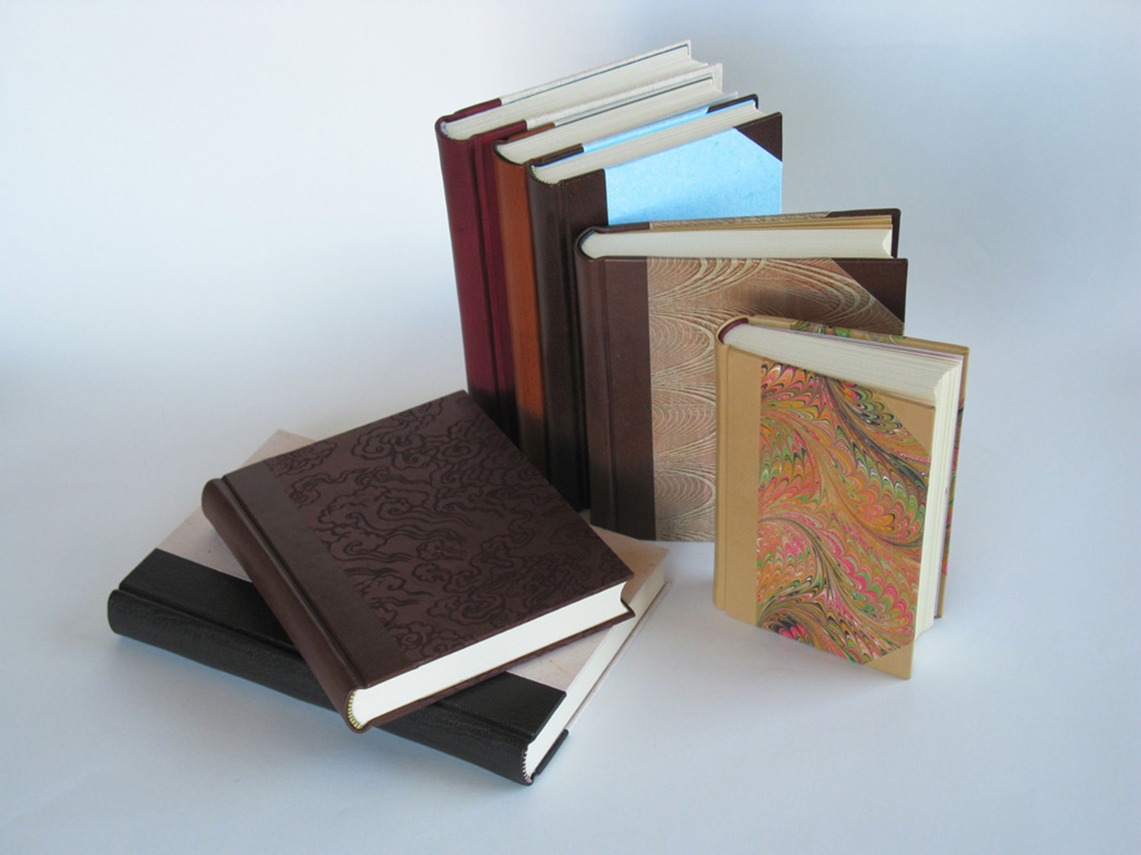
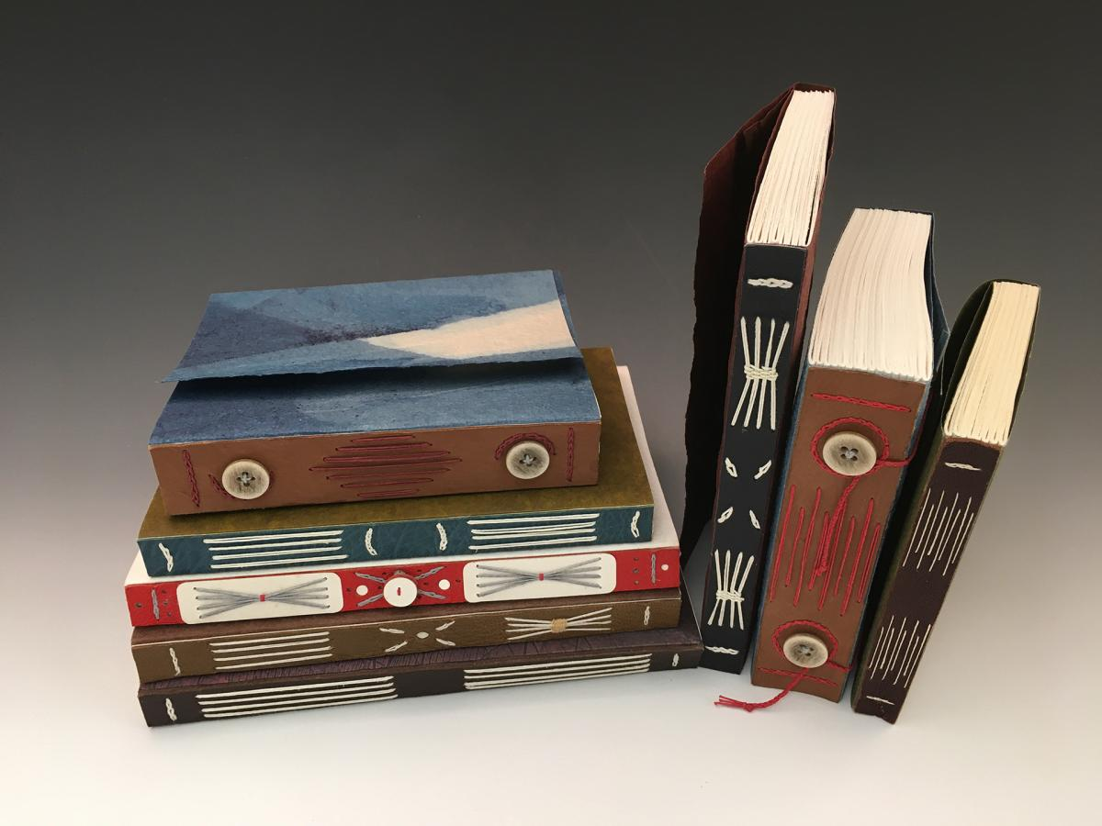
hand bound books and journals
by university of alabama book arts program

